Slide 1
Bomb Lab
Instructors:
Yunju Baek

Slide 2

Agenda
Bomb Lab Overview
Assembly Refresher
Introduction to GDB
Unix Refresher
Bomb Lab Demo

Slide 3
What is Bomb Lab?
An exercise in reading x86-64 assembly code.
A chance to practice using GDB (a debugger).
Why?
x86 assembly is low level machine code. Useful for understanding security exploits or tuning performance.
GDB can save you days of work in future labs and can be helpful long after you finish this class.

Slide 4
Downloading Your Bomb
All the details you’ll need are in the write-up, which you most definitely have to read carefully before starting this lab anyway.
Please Read The Writeup.

Slide 5
Downloading Your Bomb
Fine, here are some highlights of the write-up:
Bombs can only run on the CSEDell machines. They fail if you run them locally or on another server.
Your bomb is unique to you. Dr. Evil has created one million billion bombs, and can distribute as many new ones as he pleases.
Bombs have six phases which get progressively harder more fun to use.

Slide 6
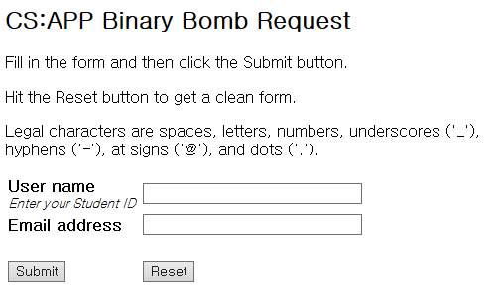
Get Your Bomb
http://164.125.68.221:15213

Slide 7

Examining Your Bomb
You get:
An executable
A readme
A heavily redacted source file
Source file just makes fun of you.
Outsmart Dr. Evil by examining the executable

Slide 8
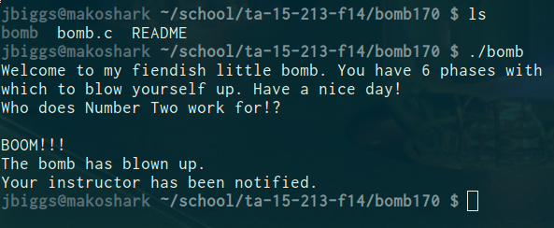
Detonating Your Bomb
Blowing up your bomb notifies server.
Dr. Evil takes 0.5 of your points each time.
It’s very easy to prevent explosions using break points in GDB. More information on that soon.

Slide 9
Detonating Your Bomb
Inputting the correct string moves you to the next phase.
Don’t tamper with the bomb. Skipping or jumping between phases detonates the bomb.
You have to solve the phases in order they are given. Finishing a phase also notifies server automatically.

Slide 10
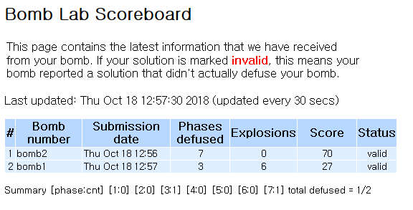
Bomb Lab Scoreboard
http://164.125.68.221:15213/scoreboard

Slide 11
Bomb Hints
Dr. Evil may be evil, but he isn’t cruel. You may assume that functions do what their name implies
i.e. phase_1() is most likely the first phase. printf() is just printf(). If there is an explode_bomb() function, it would probably help to set a breakpoint there!
Use the man pages for library functions. Although you can examine the assembly for snprintf(), we assure you that it’s easier to use the man pages ($ man snprintf) than to decipher assembly code for system calls.

Slide 12
A heavily redacted source file: bomb.c
/* Do all sorts of secret stuff that makes the bomb harder to defuse. */
initialize_bomb();
printf("Welcome to my fiendish little bomb. You have 6 phases with\n");
printf("which to blow yourself up. Have a nice day!\n");
/* Hmm... Six phases must be more secure than one phase! */
input = read_line(); /* Get input */
phase_1(input); /* Run the phase */
phase_defused(); /* Drat! They figured it out!
* Let me know how they did it. */
printf("Phase 1 defused. How about the next one?\n");
/* The second phase is harder. No one will ever figure out
* how to defuse this... */
input = read_line();
phase_2(input);
phase_defused();
printf("That's number 2. Keep going!\n");

Slide 13

x64 Assembly: Registers
%rax
%eax
%r8
Return
%r8d
Arg 5
%rbx
Arg 6
%ebx
%r9
%r9d
%rcx
%ecx
%r10
Arg 4
%r10d
Arg 3
%rdx
%edx
%r11
%r11d
Arg 2
%rsi
%esi
%r12
%r12d
Arg 1
%rdi
%edi
%r13
%r13d
Stack ptr
%rsp
%esp
%r14
%r14d
%rbp
%ebp
%r15
%r15d

Slide 14
x64 Assembly: Operands
Type | Syntax | Example | Notes
Constants | Start with $ | $-42 $0x15213b | Don’t mix up decimal and hex
Registers | Start with % | %esi %rax | Can store values or addresses
Memory Locations | Parentheses around a register or an addressing mode | (%rbx) 0x1c(%rax) 0x4(%rcx, %rdi, 0x1) | Parentheses dereference. Look up addressing modes!

Slide 15
x64 Assembly: Arithmetic Operations
Instruction
Effect
mov %rbx, %rdx
add (%rdx), %r8
mul $3, %r8
sub $1, %r8
lea (%rdx,%rbx,2), %rdx
rdx = rbx
r8 += value at rdx
r8 *= 3
r8--
rdx = rdx + rbx*2
Doesn’t dereference

Slide 16
x64 Assembly: Comparisons
Comparison, cmp, compares two values
Result determines next conditional jump instruction
cmp b,a computes a-b, test b,a computes a&b
Pay attention to operand order
If %r10 > %r9, then jump to 8675309
cmpl %r9, %r10
jg 8675309

Slide 17
x64 Assembly: Jumps
Instruction | Effect | Instruction | Effect
jmp | Always jump | ja | Jump if above (unsigned >)
je/jz | Jump if eq / zero | jae | Jump if above / equal
jne/jnz | Jump if !eq / !zero | jb | Jump if below (unsigned <)
jg | Jump if greater | jbe | Jump if below / equal
jge | Jump if greater / eq | js | Jump if sign bit is 1 (neg)
jl | Jump if less | jns | Jump if sign bit is 0 (pos)
jle | Jump if less / eq

Slide 18
x64 Assembly: A Quick Drill
cmp $0x15213, %r12
jge deadbeef
cmp %rax, %rdi
jae 15213b
test %r8, %r8
jnz (%rsi)
If , jump to addr 0xdeadbeef
If , jump to addr 0x15213b
If , jump to .

Slide 19
x64 Assembly: A Quick Drill
cmp $0x15213, %r12
jge deadbeef
cmp %rax, %rdi
jae 15213b
test %r8, %r8
jnz (%rsi)
If %r12 >= 0x15213, jump to 0xdeadbeef
Notes:
jge 크거나 같거나
0x15213는 상수

Slide 20
x64 Assembly: A Quick Drill
cmp $0x15213, %r12
jge deadbeef
cmp %rax, %rdi
jae 15213b
test %r8, %r8
jnz (%rsi)
If the unsigned value of %rdi is at or above the unsigned value of %rax, jump to 0x15213b.
Notes:
jae는 앞에 jge와 동일한 의미, 즉 크거나 같거나
그렇지만 unsigned value에 대한 operation이다.
즉 %rdi에 있는 값이 %rax 값보다 크거나 같으면
0x15213b로 점프한다.
test는 and연산

Slide 21
x64 Assembly: A Quick Drill
cmp $0x15213, %r12
jge deadbeef
cmp %rax, %rdi
jae 15213b
test %r8, %r8
jnz (%rsi)
If %r8 & %r8 is not zero, jump to the address stored in %rsi.

Slide 22
Diffusing Your Bomb
objdump -t bomb examines the symbol table
objdump -d bomb disassembles all bomb code
strings bomb prints all printable strings
gdb bomb will open up the GNU Debugger
Examine while stepping through your program
registers
the stack
contents of program memory
instruction stream
Notes:
자 그럼 실행파일만 가지고 이게 어떤 코드인지 어떻게 아느냐.
리버스 엔지니어링을 해야한다.

Slide 23

Diffusing Your Bomb
0000000000400e8d <phase_1>:
400e8d: 48 83 ec 08 sub $0x8,%rsp
400e91: be 30 24 40 00 mov $0x402430,%esi
400e96: e8 03 05 00 00 callq 40139e <strings_not_equal>
400e9b: 85 c0 test %eax,%eax
400e9d: 74 05 je 400ea4 <phase_1+0x17>
400e9f: e8 f9 05 00 00 callq 40149d <explode_bomb>
400ea4: 48 83 c4 08 add $0x8,%rsp
400ea8: c3 retq
objdump -d
000000000040141d g F .text 0000000000000002 initialize_bomb_solve
000000000040141f g F .text 000000000000003d blank_line
00000000004017d9 g F .text 00000000000007fc submitr
0000000000400f0d g F .text 000000000000016d phase_3
0000000000400e8d g F .text 000000000000001c phase_1
000000000040135b g F .text 0000000000000025 invalid_phase
0000000000401ffd g F .text 00000000000001d5 init_driver
0000000000000000 F *UND* 0000000000000000 alarm@@GLIBC_2.2.5
objdump -t

Slide 24
Using gdb
break <location>
Stop execution at function name or address
Reset breakpoints when restarting gdb
run <args>
Run program with args <args>
Convenient for specifying text file with answers
disas <fun>, but not dis
stepi / nexti
Steps / does not step through function calls
Notes:
disas: 프로그램의 일부분을 어셈블리 코드로 보여준다.
dis: 모든 break 포인트를 지운다.
next: 함수호출시 한줄로 처리하여 함수를 수행한다.
setp: 함수호출시 함수 안으로 들어간다.
step(i) C언어 소스를 i줄만큼 실해한다.

Slide 25
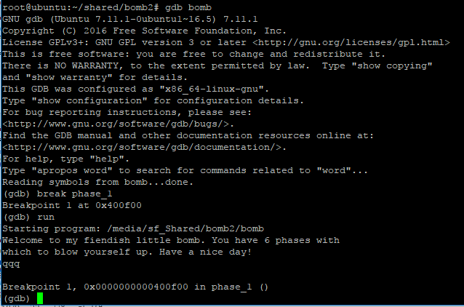
Using gdb

Slide 26
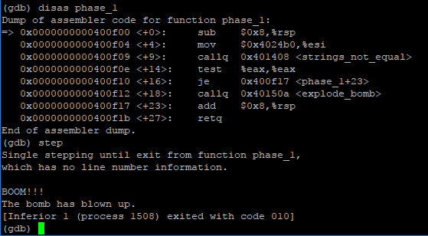
Using gdb

Slide 27
Using gdb
info registers
Print hex values in every register
print (/x or /d) $eax - Yes, use $
Print hex or decimal contents of %eax
x $register, x 0xaddress
Prints what’s in the register / at the given address
By default, prints one word (4 bytes)
Specify format: /s, /[num][size][format]
x/8a 0x15213
x/4wd 0xdeadbeef
Notes:
o : 8진법으로 보여줌 x : 16진법으로 보여줌 u : 10진법으로 보여줌 t : 2진법으로 보여줌 b : 1 byte 단위로 보여줌(byte) h : 2 byte 단위로 보여줌(half word) w: 4 byte 단위로 보여줌(word) - 난 2byte로 알고 있지만 여기선 4바이트로 쓰이나 보다.... g : 8 byte 단위로 보여줌(giant)
a: address size

Slide 28
sscanf
Bomb uses sscanf for reading strings
Figure out what phase expects for input
Check out man sscanf for formatting string details

Slide 29
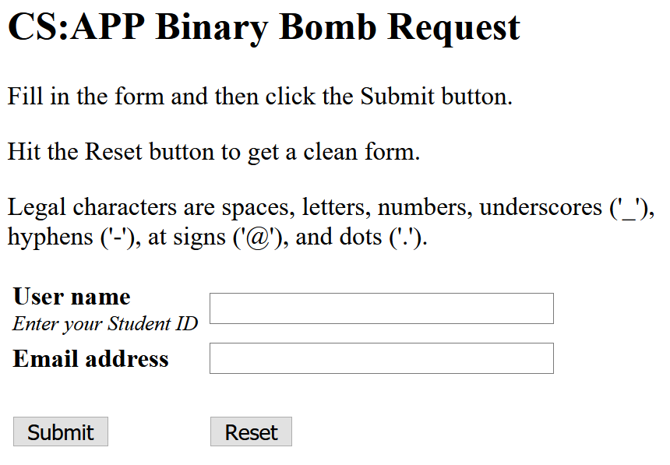
Summary
Download your own bomb and defuse it!
http://164.125.68.221:15213/
제출기한 : 11월 15일 11:59 PM
반드시 실습 서버에서 수행할 것!! (그 외의 환경에서는 실행 불가)
제출물
BombID_학번.pdf: 각 phase에서 자신이 defusing code를 찾은 과정을 간략히 설명
MS워드또는 HWP 파일로 작성 후 PDF 파일로 출력
표지없이 간단히 첫 장 상단에 이름과 학번만 명시
5장을 넘지 말 것, 초과시 보고서 점수 감점 사유.
PLATO로 제출

Slide 30
Hints!!
Each bomb phase tests a different aspect of machine language programs:
Phase 1: string comparison
Phase 2: loops
Phase 3: conditionals/switches
Phase 4: recursive calls and the stack discipline
Phase 5: pointers
Phase 6: linked lists/pointers/structs

Slide 31
If you get stuck
Please read the writeup. Please read the writeup. Please Read The Writeup.
View lecture notes for Machine-Level Programming
If you have any questions, use the Q&A bulletin board on PLATO
man gdb, man sscanf, man objdump

